Slide 1

Sales and Revenue Analytics Retail Dashboard Global Electronics Retailer Capstone Project 1 – Presentation
Done By :
Sujith Gopinathan

Slide 2
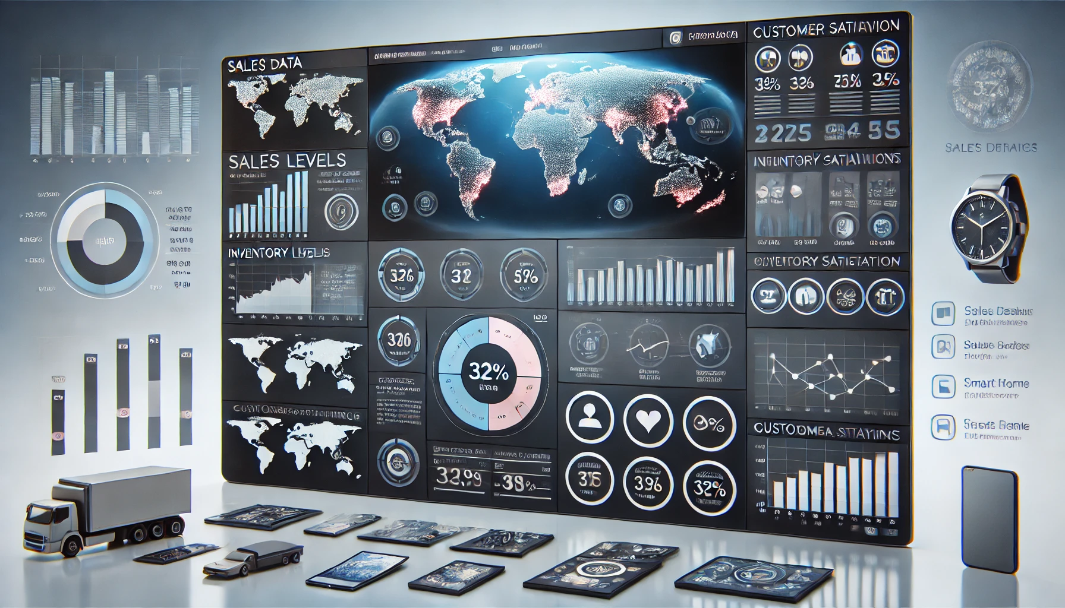
Motive of This Project
The main goal of this project is to help the retailer make better decisions using data insights.
We want to identify sales trends and understand customer preferences for more effective marketing.
We also aim to optimize profit margins to guide smarter pricing decisions.
The project aims to support business growth and competitiveness in the electronics market through an interactive Power BI dashboard.

Slide 3
Problem Statements
Need for Real-Time Insights: There's a need for real-time data to improve decision-making and responsiveness.
Lack of Customer Insights: Limited understanding of customer demographics hinders targeted marketing.
Variable Profit Margins: Profit margins vary by product and region, causing uncertainty in pricing.
Fluctuating Sales: Inconsistent sales make it difficult to identify top-performing products.

Slide 4
About the Dataset
File Size: Approximately 4.7 MB.
The dataset is available in Excel format (.xlsx), making it easy to load into Power BI for analysis.
Contents of the Dataset:
Sales Data: Transaction ID, product ID, quantity sold, sale date, and total sales amount.
Customer Data: Customer ID, age, gender, location, and purchase history.
Inventory Data: Stock levels, product IDs, and turnover rates.
Product Data: Product ID, name, category, price, and profit margin.
Regional Data: Sales performance by geographic area, including region names and sales figures.
The dataset provides essential information for analyzing sales trends, customer behavior, and inventory management in Power BI.

Slide 5
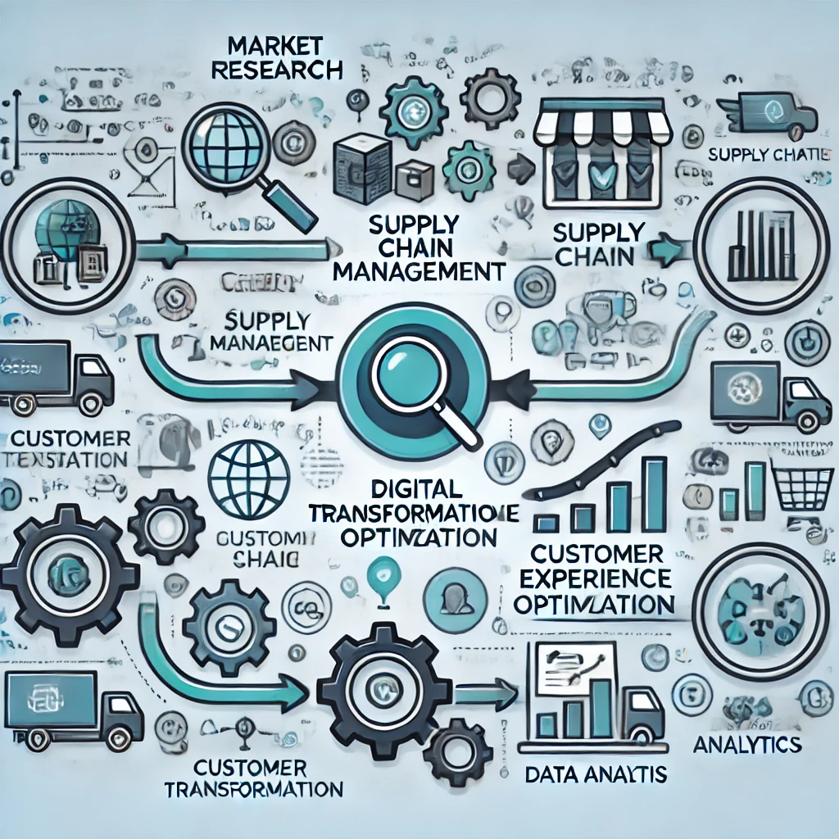
Methodology
Data Collection: Gather relevant sales, customer, inventory, and product data from open-source data websites.
Data Cleaning: Clean the dataset to remove inaccuracies and fill in missing values.
Data Import: Load the cleaned data into Power BI for analysis.
Data Modeling: Create relationships between different datasets for comprehensive analysis.
Dashboard Design: Develop interactive dashboards in Power BI to visualize.

Slide 6
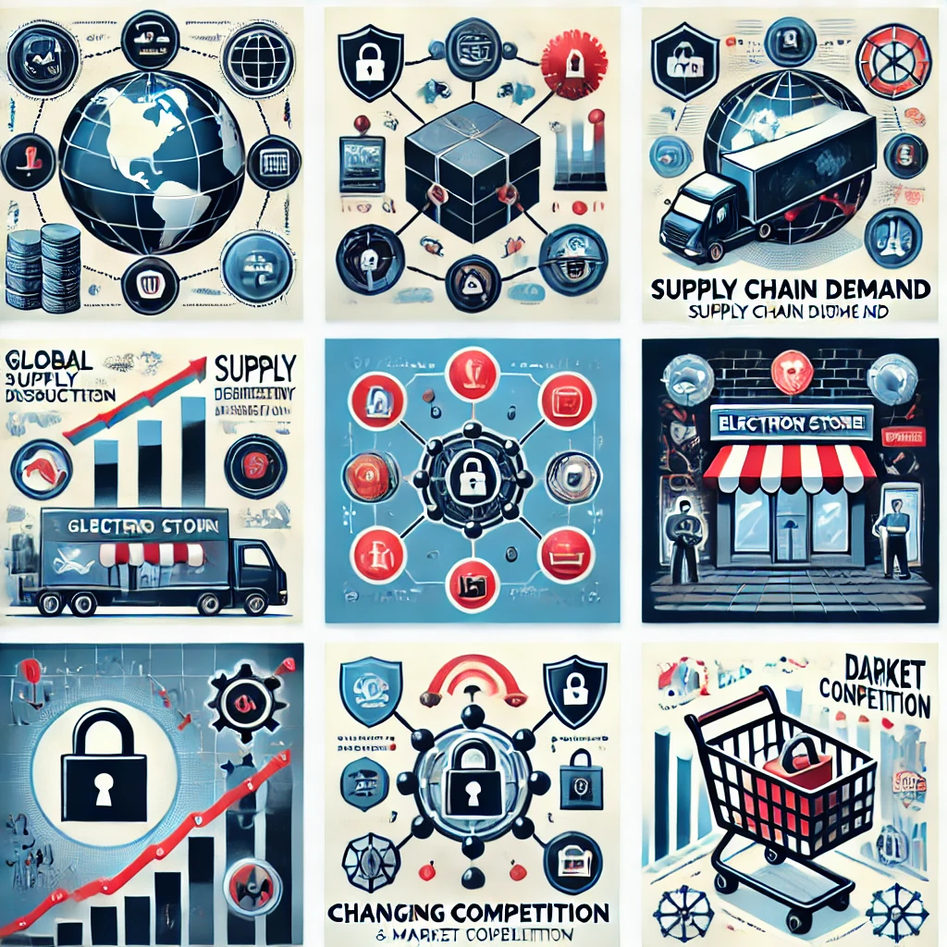
Risks and Challenges
Data Quality Issues: Inaccurate or incomplete data can lead to misleading insights, making it essential to ensure thorough data cleaning.
Changing Business Needs: The retailer's priorities might shift during the project, requiring adjustments to the analysis and insights provided.
Integration Difficulties: Combining data from various sources may pose challenges related to compatibility and structure, requiring careful modeling.

Slide 7

Solution
Comprehensive Data Cleaning:
Implement a thorough data cleaning process to address any inaccuracies, missing values, or duplicates in the dataset. This ensures the reliability of the analysis and the validity of insights drawn from the data.
Data Integrity and User Feedback:
Implement a thorough data cleaning process to ensure accuracy and engage stakeholders for feedback on the dashboard design. This approach will enhance the reliability of insights and ensure the dashboard meets user needs.

Slide 8
Thank You

